Slide 1
Periodic Table
Identifying groups and their properties

Slide 2
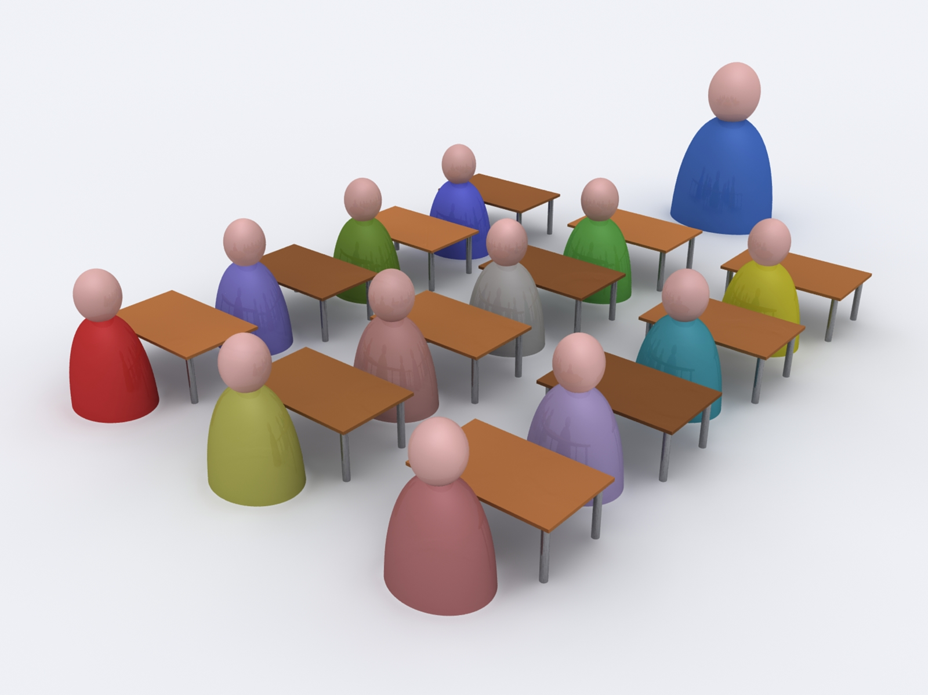
Successful learning criteria
Students will be able to describe the properties of each group in the periodic table
Students will be able to name the different groups in the periodic be able to explain the trends of the periods across the periodic table
Students will be able to explain the trends of the periods across the periodic table

Slide 3
Vocabulary
Atom
Nucleus
Proton
Electron
Neutron
Periodic Table

Slide 4
Atom
the smallest particle of a chemical element that can exist.

Slide 5
Atom
The definition of an atom is the smallest component of an element, characterised by a sharing of the chemical properties of the element and a nucleus with neutrons, protons and electrons.

Slide 6
SWBAT define atom

Slide 7
SWBAT define atomic number and atomic mass

Slide 8
Atomic number
the number of protons in the nucleus of an atom, each element is different and this number tells us where it is in the periodic table

Slide 9
Atomic mass
Vocabulary
Mass – commonly how much something weighs
the mass of an atom of a chemical element expressed in atomic mass units. It is approximately equivalent to the number of protons and neutrons in the atom

Slide 10
Helium

Slide 11
Periodic Table handout
This is your periodic table to permanently place into your workbook.

Slide 12
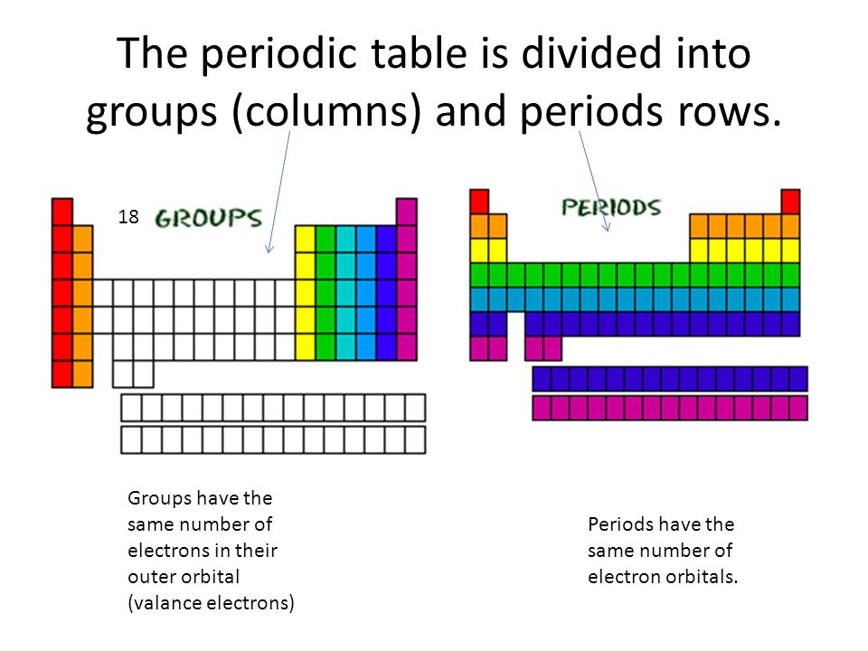
Groups are the columns of the periodic table and are labeled 1 - 18
Periods are the rows of the periodic table
Notes:
there are different ways in which the periodic table is

Slide 13
Columns of elements are called groups
Elements in each group have similar but not identical properties

Slide 14
Each horizontal row of elements is called a period
The elements in a period are not alike in properties
In fact, the properties change greatly across every row
the first element in a period is always an extremely active solid
the last element in a period is always an inactive gas

Slide 15
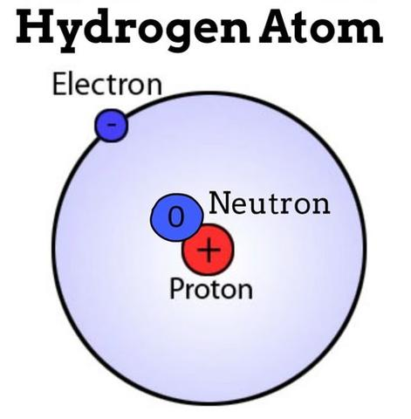
Hydrogen
The Hydrogen square sits on top of the first group, but it is not a member of that group
Hydrogen is in a class of its own
It’s a gas at room temperature
It has one proton and one electron

Slide 16


Slide 17
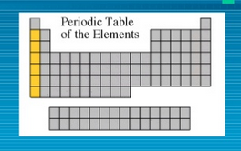
Alkali Metals
The alkali group is found in the first column of the periodic table
Atoms of the alkali metals are highly reactive
They react violently with water
Alkali metals are never found as free elements in nature, they are always bonded with another element
These metals are shiny, have the consistency of clay, and are easily cut with a knife
Notes:
What do we mean by the word reactive?

Slide 18
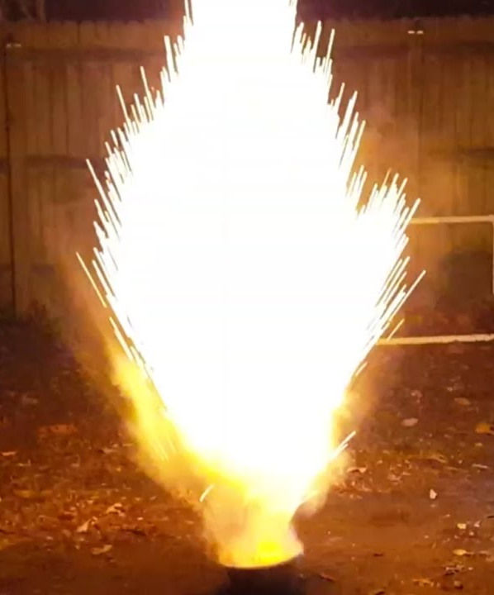
What does it mean to be reactive?
In chemistry, reactivity is a measure of how readily a substance undergoes a chemical reaction.
Some elements are so reactive that they can only found naturally bonded with other elements that keep them stable
Notes:
Compounds are a thing that is composed of two or more separate elements; a mixture

Slide 19
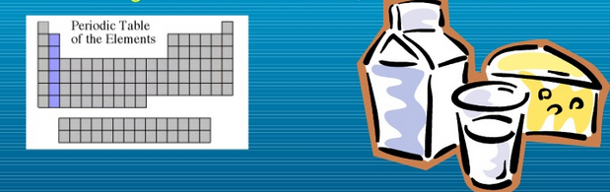
Alkaline Earth Metals are group 2
Alkaline Earth Metals are the 2nd column on the periodic table
Alkaline Earth Metals are always combined with other elements in nature
Alkaline earth metals include nutrients like magnesium and calcium

Slide 20
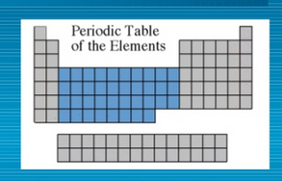
Transition Metals
Transition Elements include groups 3 to 12
These are metals that will be most familiar and include copper, tin, zinc, iron, nickel, gold and silver
They are good conductors of heat and electricity
They are less reactive
Usually harder metals and are used in jewellery and construction
The compounds of transition metals are usually brightly coloured and are often used to colour paints

Slide 21
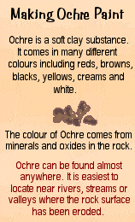

Transition Elements
Transition elements have properties similar to one another and to other metals, but their properties do not fit in with those of any other group
Notes:
Many transition metals combine chemically with oxygen to form compounds called oxides

Slide 22
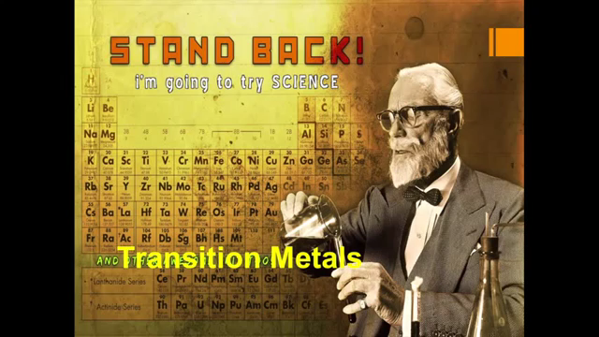

Slide 23
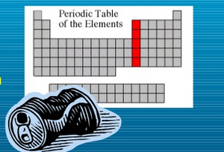
Boron Group
Group 13, the Boron Family is named after the first element in the family
Aluminium is in this group and is one of the most abundant metals in the earths' crust
Notes:
Silicon and Germanium are important semiconductors used in computers

Slide 24
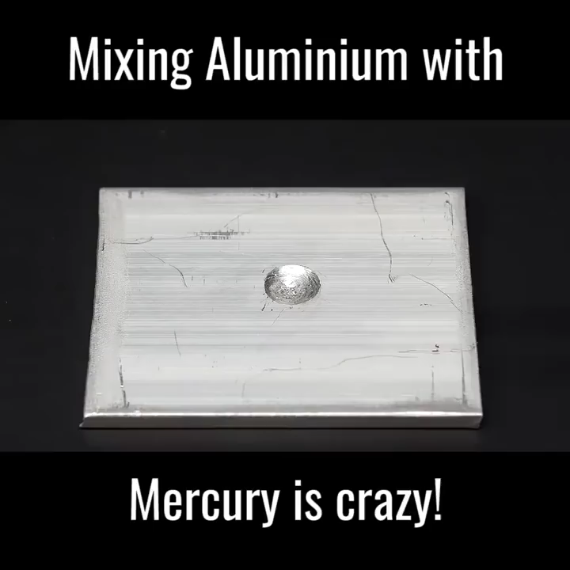

Slide 25
Successful learning criteria
Students will be able to describe the properties of each group in the periodic table
Students will be able to name the different groups in the periodic be able to explain the trends of the periods across the periodic table
Students will be able to explain the trends of the periods across the periodic table

Slide 26
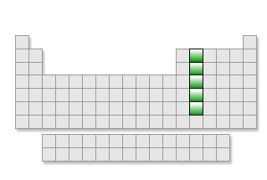
The Carbon group
Group 14, the carbon group has five members
They are carbon, silicon, germanium, tin, and lead.
The element carbon is the basis of life. It is found in all living material.
Silicon is a semiconductor used commonly in computer chips and solar cells.
It is also the second most abundant element in the earth's crust.

Slide 27
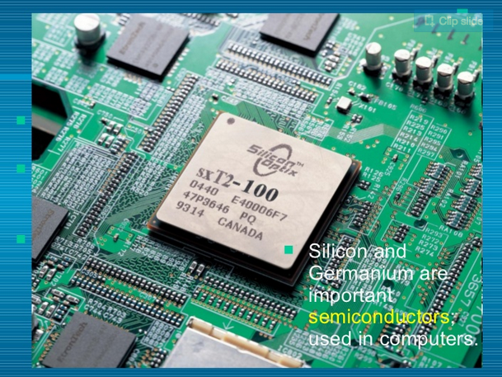
The Carbon Group
Silicon dioxide, SiO₂, is the major component of glass.
Germanium has important semiconductor properties and is used in the computer industry

Slide 28
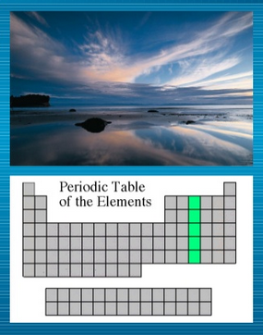
Nitrogen Group
Group 15, the Nitrogen group is named after the element that makes up 78% of our atmosphere
This family includes non-metals, and metals
Other elements in this family are phosphorus, arsenic, antimony and bismuth

Slide 29
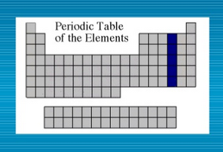
Oxygen Group
Group 16, the Boron group is named after the first element in the family
Aluminium is one of the most abundant metals in the earths' crust
Oxygen is the most abundant element in the earth’s curst
It is extremely active and combines with almost all elements
Sulfur is an element from this group
Many things that stink contain sulfur
rotten eggs, garlic, skunks etc.

Slide 30
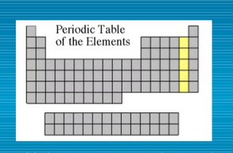
Halogen Group
Group 17, the Halogen Group are the most active non-metals
Elements in this family are fluorine, chlorine, bromine, iodine and astatine
They are never found free in nature
They react with alkali metals to form salts

Slide 31
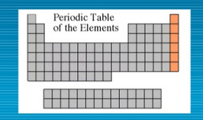
Noble Gases
Group 18, the Noble Gases are colourless gases that are extremely unreactive
Due to their unreactive nature they are called “inert”
The group includes helium, neon, argon, krypton, xenon and radon
All noble gases are found in small amounts in the earth’s atmosphere

Slide 32
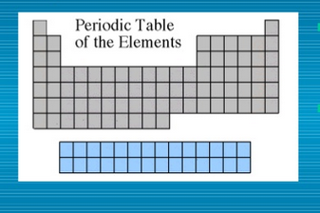
Rare Earth Elements
The thirty rare earth elements are composed of lanthanide and actinide series

Slide 33
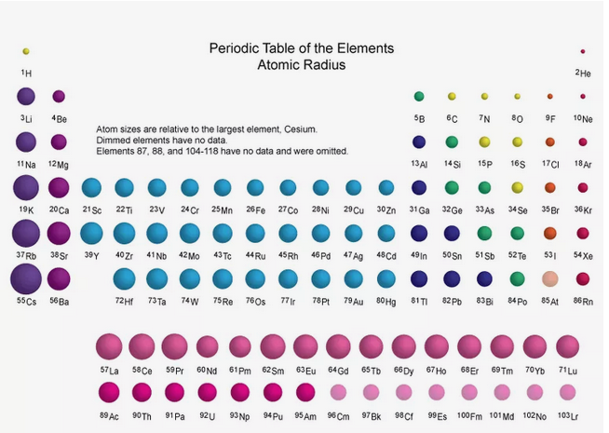
Across the periodic table
Atomic radius is measured from the centre of the nucleus to the outermost electron shell.
The general trend of atomic radius is that it increases as you move down a group, and decreases as you move to the right across a period.
Notes:
As we go across the periods the atomic number increases. What does this mean? It means we have an increasing number of protons in the nucleus of the atom
How can it be that the nucleus is getting bigger but the size of the atom is decreasing?
the more protons in the nucleus, the more positive attraction they emit, drawing the electrons that fly around the nucleus to spin closer to the nucleus

Slide 34
Across the periodic table
On the bottom of the table we see a slight bump in the trend. Two elements decrease and then increase again, seemingly throwing the trend off. This is an example of how these elements behave differently, and a reminder that trends do not necessarily apply to every instance

Slide 35
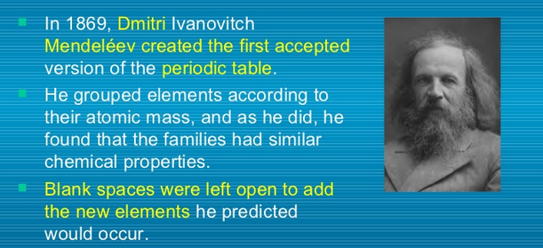
Mendeleev

Slide 36

Notes:
4 minutes

Slide 37

Notes:
12 minutes

Slide 38
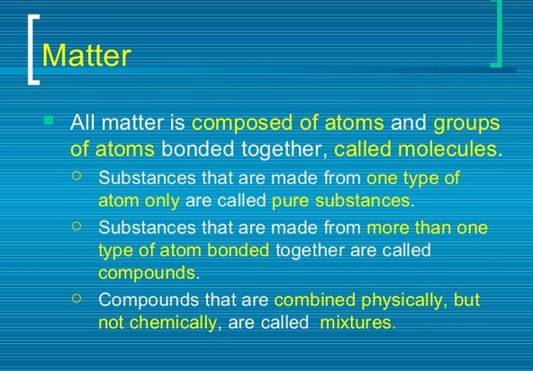

Slide 39
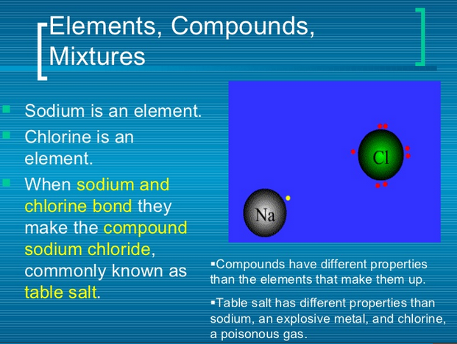

Slide 40
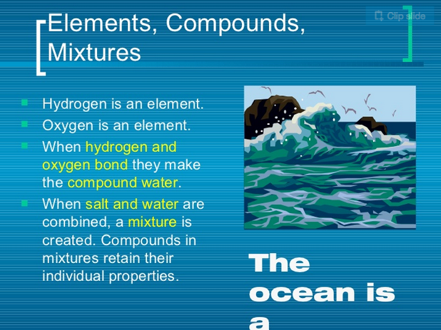

Slide 41
